Slide 1
UNIT-I

Slide 2
Decision Making statements
Decision making is anticipation of conditions occurring while execution of the program and specifying actions taken according to the conditions.
Python programming language assumes any non-zero and non-null values as True, and if it is either zero or null, then it is assumed as False value.
Statement | Description
if statements | if statement consists of a boolean expression followed by one or more statements.
if...else statements | if statement can be followed by an optional else statement, which executes when the boolean expression is FALSE.
nested if statements | You can use one if or else if statement inside another if or else if statement(s).

Slide 3
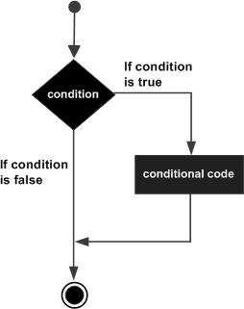

The if Statement
First, the condition is tested. If the condition is True, then the statements given after colon (:) are executed.
a=10 b=15
if a < b:
print “B is big” print “B value is”,b

Slide 4

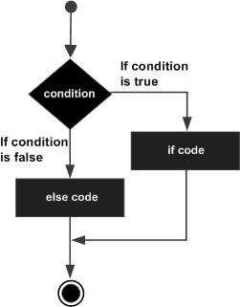
The if ... else statement
a=48 b=34
if a < b:
print “B is big” print “B value is”, b
else:
print “A is big” print “A value is”, a
print “END”
An else statement contains the block of code that executes if the conditional expression in the if statement resolves to 0 or a FALSE value.

Slide 5
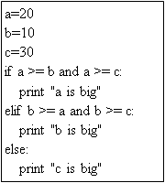
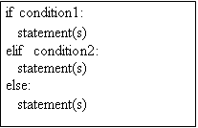
The elif Statement
The elif statement allows you to check multiple expressions for True and execute a block of code as soon as one of the conditions evaluates to True.

Slide 6
Decision Loops
Loop Type | Description
while loop | Repeats a statement or group of statements while a given condition is TRUE. It tests the condition before executing the loop body.
for loop | Executes a sequence of statements multiple times and abbreviates the code that manages the loop variable.
nested loops | You can use one or more loop inside any another while, for loop.

Slide 7
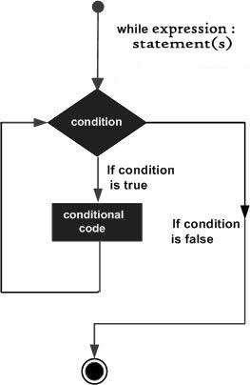
The while Loop
while expression:
statement(s)
A while loop statement in Python programming language repeatedly executes a target statement as long as a given condition is True.
i=1
while i < 4:
print I
i+=1
print “END”

Slide 8
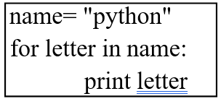
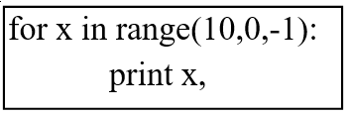
The for loop:
The for loop is useful to iterate over the elements of a sequence. It means, the for loop can be used to execute a group of statements repeatedly depending upon the number of elements in the sequence.
The for loop is useful to iterate over the elements of a sequence. It means, the for loop can be used to execute a group of statements repeatedly depending upon the number of elements in the sequence.
for var in sequence:
statement (s)
for i range(1,5):
print i
print “END”

Slide 9
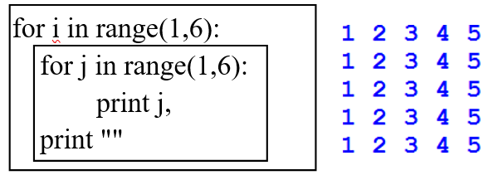
Nested Loop
It is possible to write one loop inside another loop. For example, we can write a for loop inside a while loop or a for loop inside another for loop. Such loops are called “nested loops”.

